Slide 1


Intrinsic Vowel Pitch in Children
The acoustic analysis of a child speech corpus
Notes:
Name:
Phd
You have being going through phonetics and phonology → how can we apply all those concepts together
What does it look like to do research in this field… and how we can mobilioze phonetics and phonology concepts to make it into something meaningful

Slide 2

Musical experiment

Slide 3




Are the sounds identical?
Sound A
Sound B
Sound C
→ Different instruments

Slide 4

Are the sounds identical?
Sound A
Sound B
Sound C
→ Different musical notes

Slide 5
The pronunciation of vowels
Notes:
Now, let me introduce you to our laboratory participant, our speaker, who is positioned sagittally. You might recall them from your initial encounters with phonetics in your textbooks. When we request our speaker to articulate vowels with varying qualities, our participant modulates the resonance cavities spanning from the larynx to the lips, effectively amplifying specific frequencies and shaping the formants that ultimately define the distinct vowel sounds.

Slide 6
The pronunciation of vowels
/i/
/u/
/a/
Notes:
And if we have a closer look at it, we can observe that the main articulator responsible for the shaping of the resonance cavities is the tongue thanks to changes in position and according to the place of maximal structure… this shapes what we know to be the articulatory and acoustic vowel triangles…

Slide 7

Speech experiment

Slide 8
Are the sounds identical?
F2
/i/
/u/
F1
F0
→ Different musical notes
/a/
Notes:
I referred to it as the "acoustic vowel space" because we can effectively map the articulatory vowel space onto the acoustic plane, using F1 and F2 to represent the first and second formants, respectively. Now, I'd like to give you the opportunity to listen to these three vowels, and I invite you to discern whether you can distinguish one from the others.
Now i ll let you hear three other sounds and you will tell me if you are also able to distinguish them as three different sounds. Yes , you can … well the three sounds you have just heard are the three vowels you previously heard but with the exception that I neutralized all spectral information but one… this means that in those sounds there was no F2 information there was no F1 information but still you could distinguish them because one thing was still different and that thing was the fundamental frequency …. In other words the pitch quality inherent to each vowel made you able to distinguish those vowels → this is what is called intrinsic vowel pitch.

Slide 9
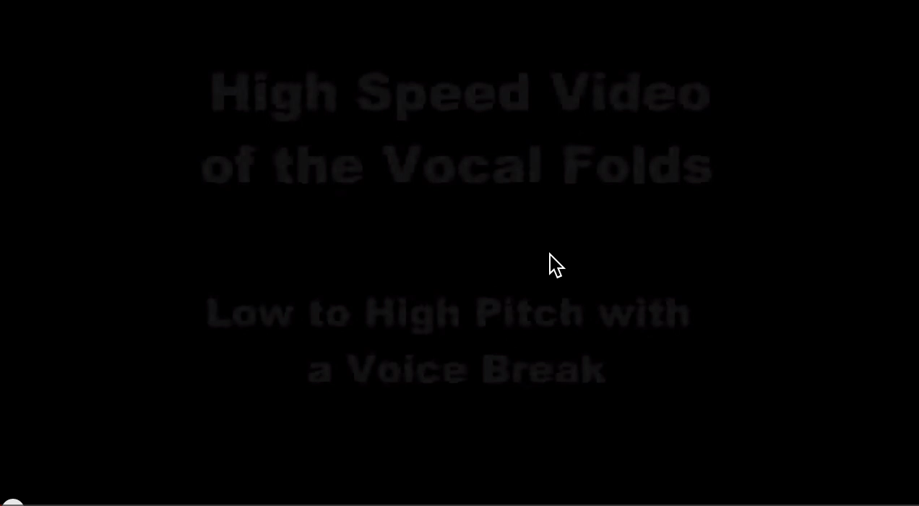
What is F0?
Frequency of vibration vocal folds during voicing
How many cycles in 1 second→ frequency in Hz
http://www.youtube.com/watch?feature=player_detailpage&v=9kHdhbEnhoA
Notes:
coordination

Slide 10







What is F0?
F0 can characterize different people
F0 can characterize different vowels
F0
Notes:
I referred to it as the "acoustic vowel space" because we can effectively map the articulatory vowel space onto the acoustic plane, using F1 and F2 to represent the first and second formants, respectively. Now, I'd like to give you the opportunity to listen to these three vowels, and I invite you to discern whether you can distinguish one from the others.
Now i ll let you hear three other sounds and you will tell me if you are also able to distinguish them as three different sounds. Yes , you can … well the three sounds you have just heard are the three vowels you previously heard but with the exception that I neutralized all spectral information but one… this means that in those sounds there was no F2 information there was no F1 information but still you could distinguish them because one thing was still different and that thing was the fundamental frequency …. In other words the pitch quality inherent to each vowel made you able to distinguish those vowels → this is what is called intrinsic vowel pitch.

Slide 11
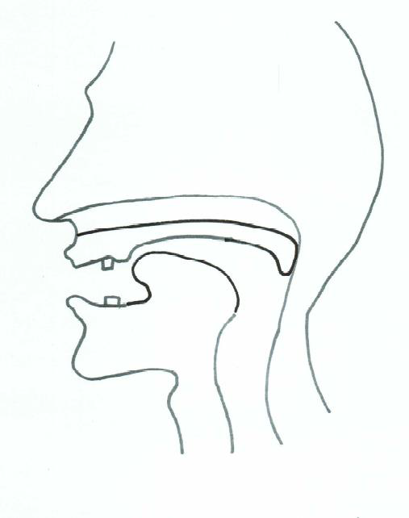
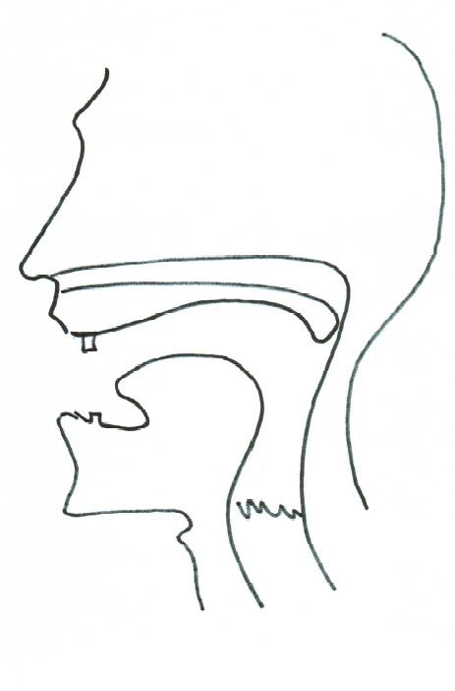
One big question ?
VS
High vowels
Low vowels
HIGH F0
LOW F0
Intrinsic Vowel Pitch (= IF0)
Notes:
Tackle one big question
One distinction
High voice vs low voice

Slide 12

Universal phenomenon attested
in all languages of the world
BUT WHY?
Notes:
Tackle one big question
One distinction
High voice vs low voice

Slide 13

Two competing theories
VS
Biomechanical
Functional
High vowels
≠
Low vowels
Notes:
Tackle one big question
One distinction
High voice vs low voice

Slide 14

Different expectations
VS
Biomechanical
Functional
Automatic
Innate
Little variability
No developmental effect
Not automatic
Acquired
Variability
Developmental effect
Notes:
Tackle one big question
One distinction
High voice vs low voice

Slide 15


Do children do it too?
Do children learn it?
Notes:
I referred to it as the "acoustic vowel space" because we can effectively map the articulatory vowel space onto the acoustic plane, using F1 and F2 to represent the first and second formants, respectively. Now, I'd like to give you the opportunity to listen to these three vowels, and I invite you to discern whether you can distinguish one from the others.
Now i ll let you hear three other sounds and you will tell me if you are also able to distinguish them as three different sounds. Yes , you can … well the three sounds you have just heard are the three vowels you previously heard but with the exception that I neutralized all spectral information but one… this means that in those sounds there was no F2 information there was no F1 information but still you could distinguish them because one thing was still different and that thing was the fundamental frequency …. In other words the pitch quality inherent to each vowel made you able to distinguish those vowels → this is what is called intrinsic vowel pitch.

Slide 16




Definition of a Research Question
Data collection
Pre-processing
Acoustic analysis
Post-processing
Stats. Analysis
Interpretation
Quantitative analysis of phonetic phenomenon through experimental methods:
We will measure X in a particular unit Y …
about the physical nature of speech sounds …
through the systematic manipulation of variables to measure/estimate phonetic variables
Independent variables
Dependent variables
Notes:
Dependent Variable: This is the variable being studied and measured. Its value depends on other factors, hence the term "dependent." It's the outcome variable, responding to changes in the independent variable(s). In a cause-and-effect relationship, the dependent variable is what you're trying to understand or predict. For example, in a study examining how studying time affects exam scores, the exam scores would be the dependent variable because they are influenced by the amount of time spent studying.
Independent Variable: This is the variable that is manipulated or controlled by the researcher. Its value doesn't depend on other variables in the context of the experiment or analysis; hence, it's "independent." Changes in the independent variable are hypothesized to cause changes in the dependent variable. Going back to the studying time and exam scores example, the independent variable would be the amount of time spent studying because it's being controlled or manipulated to observe its effect on exam scores.
In simpler terms, the dependent variable "depends" on the independent variable.

Slide 17
Definition of a Research Question
Data collection
Pre-processing
Acoustic analysis
Post-processing
Stats. Analysis
Interpretation
Is F0 different in high and low vowels produced by monolingual children acquiring Standard Belgian Dutch?
Good research questions - easy to make predictions:
- The F0 of high vowels is the same as that of low vowels
The F0 of high vowels is different than that of low vowels
The relation between F0 and high/low vowels is stable
The relation between F0 and high/low vowels changes through time

Slide 18





Definition of a Research Question
Data collection
Pre-processing
Acoustic analysis
Post-processing
Stats. Analysis
Interpretation
2 main features:
- 1 dependent variable = a specific phonetic phenomenon
- At least one independent variable = any “contextual” factor
Linguistic factors
Population factors
Biological factors
…
(language, grammar, word, phoneme, etc)
(SES, gender, regional background, monolingual, etc)
(sexe, age, anatomical differences, etc)
Notes:
Do we find the features that we needed
In the largest sense of the term
German and dutch
Main clause – subordinate clause
Monosyllabic words – multi-syllabioc words
Vowel a versu I and u
Higher versus lower economic status
Berlin vs mannheim
French accent because english is not my mother tongue
Men and women
Children teenager or elderly
Underwent surgery, with hearing impaiment and so on
So you have a lot of potential sources of variability that are often all marked to some extent in the speech of people… but when you research you have to focuse on something you cant study that all at once so you have to chose and fix clear boundaries on what you want to study

Slide 19

Definition of a Research Question
Data collection
Pre-processing
Acoustic analysis
Post-processing
Stats. Analysis
Interpretation
Is F0 different in high and low vowels produced by monolingual children acquiring Belgian Standard Dutch?
Linguistic factors
Population factors
Biological factors
…
(language, grammar, word, phoneme, etc)
(SES, regional background, monolingual, etc)
(sexe, age, anatomical differences, etc)

Slide 20
Definition of a Research Question
Data collection
Pre-processing
Acoustic analysis
Post-processing
Stats. Analysis
Interpretation
What method could I use?
- Experiment (in production/in perception)
- Spoken corpora
Corpus = “body of naturally occurring language” (McEnery, Xiao & Tono, 2006:5)
- technological progress (computer power)
- methodological progress (softwares)
- aim at objectivity, quantifiability, reproductibility

Slide 21
Definition of a Research Question
Data collection
Pre-processing
Acoustic analysis
Post-processing
Stats. Analysis
Interpretation
How to design/choose a corpus?
- speech production in naturalistic context
- representative a specific variety/usage of language
- type of media: written and/or audio and/or video and/or transcription
Decisions beforehand

Slide 22
Definition of a Research Question
Data collection
Pre-processing
Acoustic analysis
Post-processing
Stats. Analysis
Interpretation
Is F0 different in high and low vowels produced by monolingual children acquiring Standard Belgian Dutch?
Look for participants:
Control for other factors
≃ Same language (dialect background!)
≃ Socio-economic status
≃ Same health condition (eg hearing!)

Slide 23


Definition of a Research Question
Data collection
Pre-processing
Acoustic analysis
Post-processing
Stats. Analysis
Interpretation
Is F0 different in high and low vowels produced by monolingual children acquiring Dutch?
Determine sample:
Record children between ? and ?
Dream: between beginning of babbling & complex utterances
Pragmatic choice: between 6 months & 2 years
chrononlogical age is no good choice

Slide 24
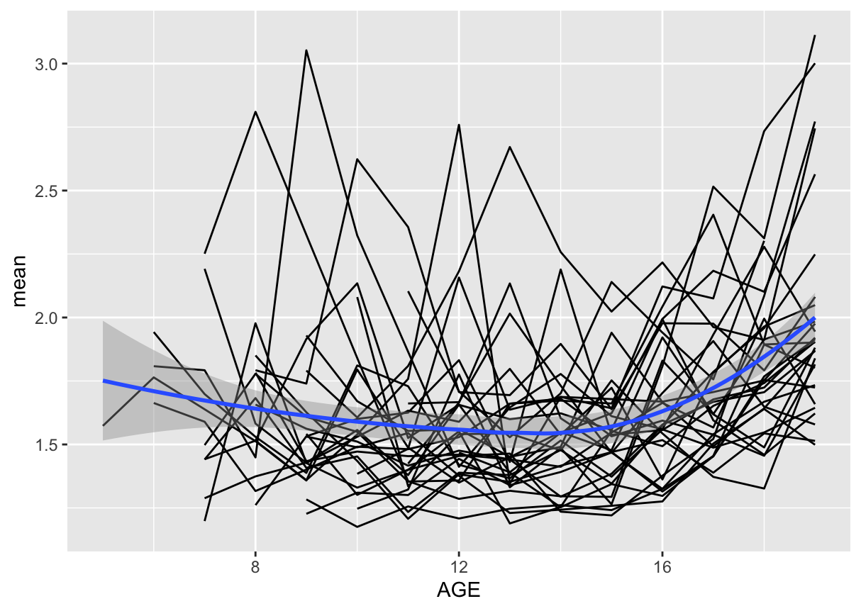
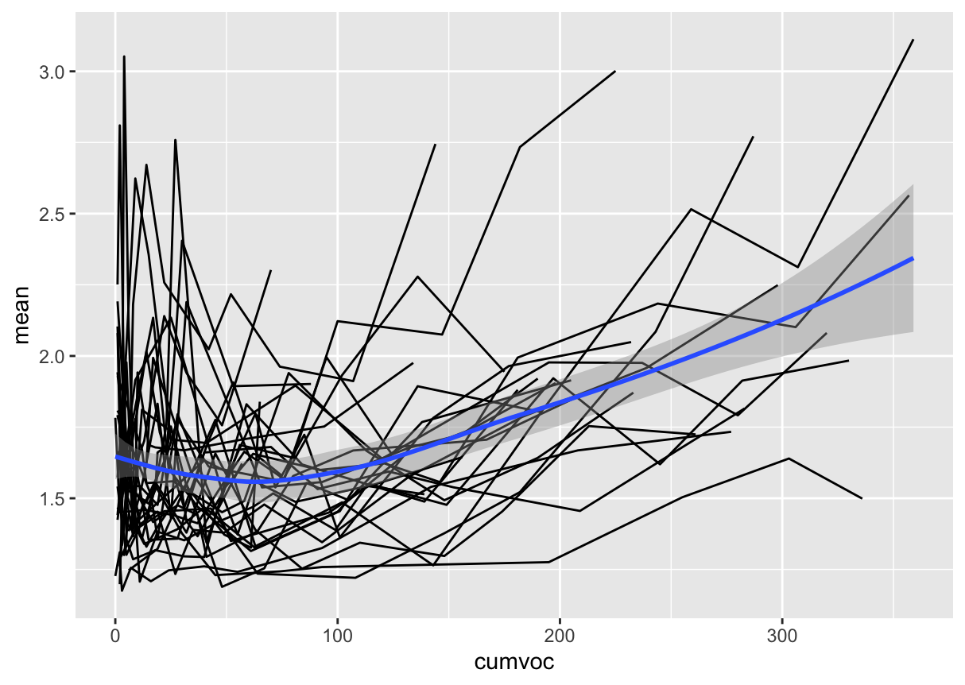
Definition of a Research Question
Data collection
Pre-processing
Acoustic analysis
Post-processing
Stats. Analysis
Interpretation
For instance: number of vowels per utterance
Expressive cumulative vocabulary is a standard estimation of the children’s growth in vocabulary for spontaneous longitudinal recordings and is computed by counting the appearance of each new word types iteratively for each recording session.

Slide 25
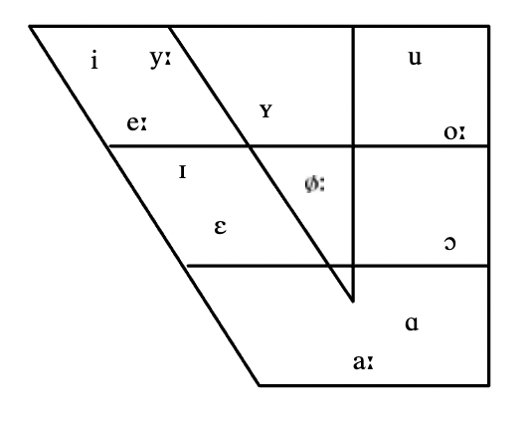
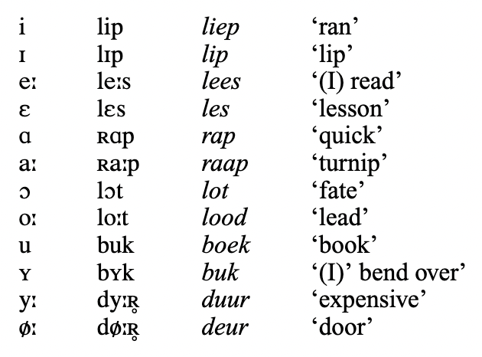





Definition of a Research Question
Data collection
Pre-processing
Acoustic analysis
Post-processing
Stats. Analysis
Interpretation
Is F0 different in high and low vowels produced by monolingual children acquiring Standard Belgian Dutch?
Standard Belgian Dutch
(Verhoeven, 2005)
Notes:
Turnip = vegetable purple and white

Slide 26

Definition of a Research Question
Data collection
Pre-processing
Acoustic analysis
Post-processing
Stats. Analysis
Interpretation
Is F0 different in high and low vowels produced by monolingual children acquiring Dutch?
Sound acoustic features:
- Time (When ?)
Amplitude (How strong?) Structure
Frequency (How high?)
First frequency that is amplified in the signal

Slide 27


Definition of a Research Question
Data collection
Pre-processing
Acoustic analysis
Post-processing
Stats. Analysis
Interpretation
Spontaneous play

Slide 28
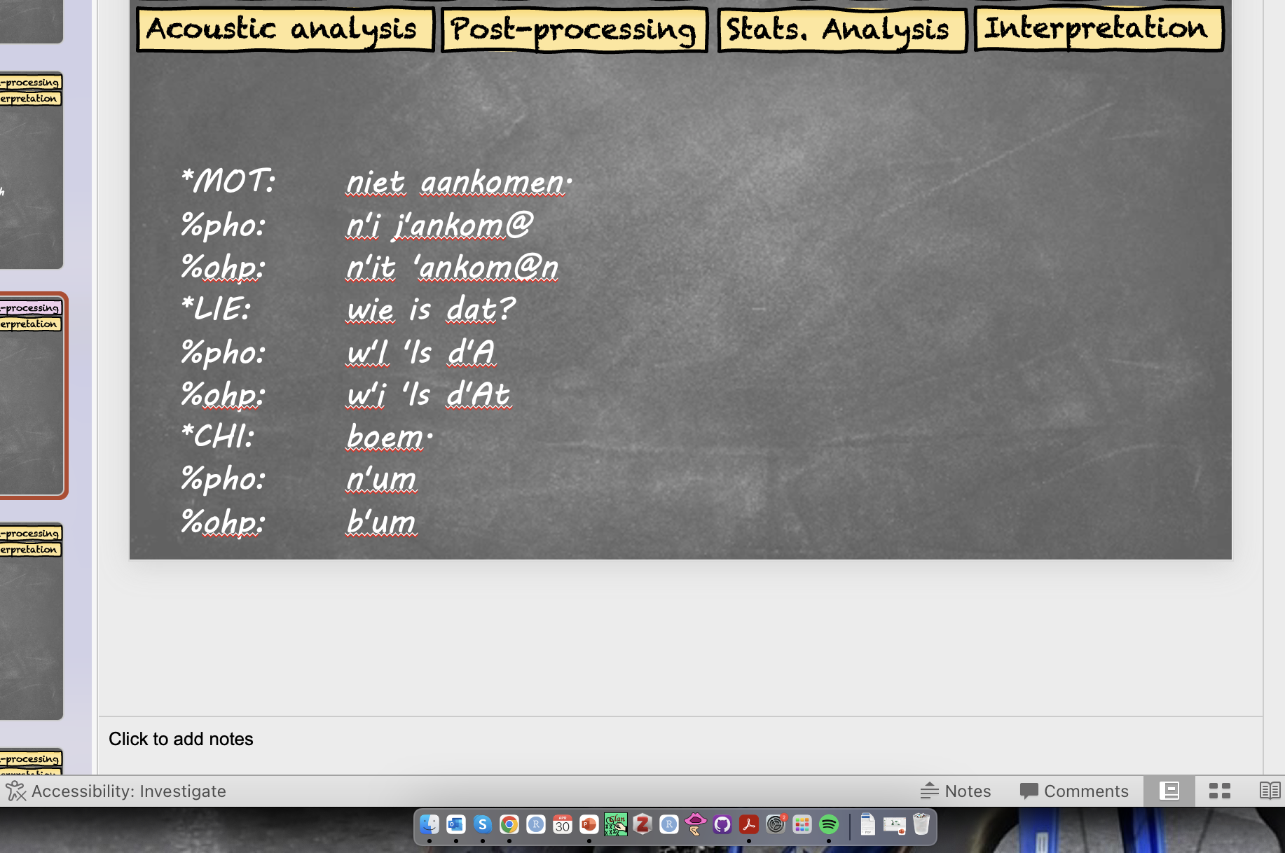

Definition of a Research Question
Data collection
Pre-processing
Acoustic analysis
Post-processing
Stats. Analysis
Interpretation
Clan Format
Praat Format
Standard for analysis of databanks such as Corpus TalkBank
Easy transcription in CHAT format (acquisition studies)
Timing annotations
Several annotation levels
CHAT format can be exported to PRAAT
Precise phonetic information
Graphic interface for phonetic analyses
Possibility to automate analysis by coding (potentially in Python or R through packages)

Slide 29
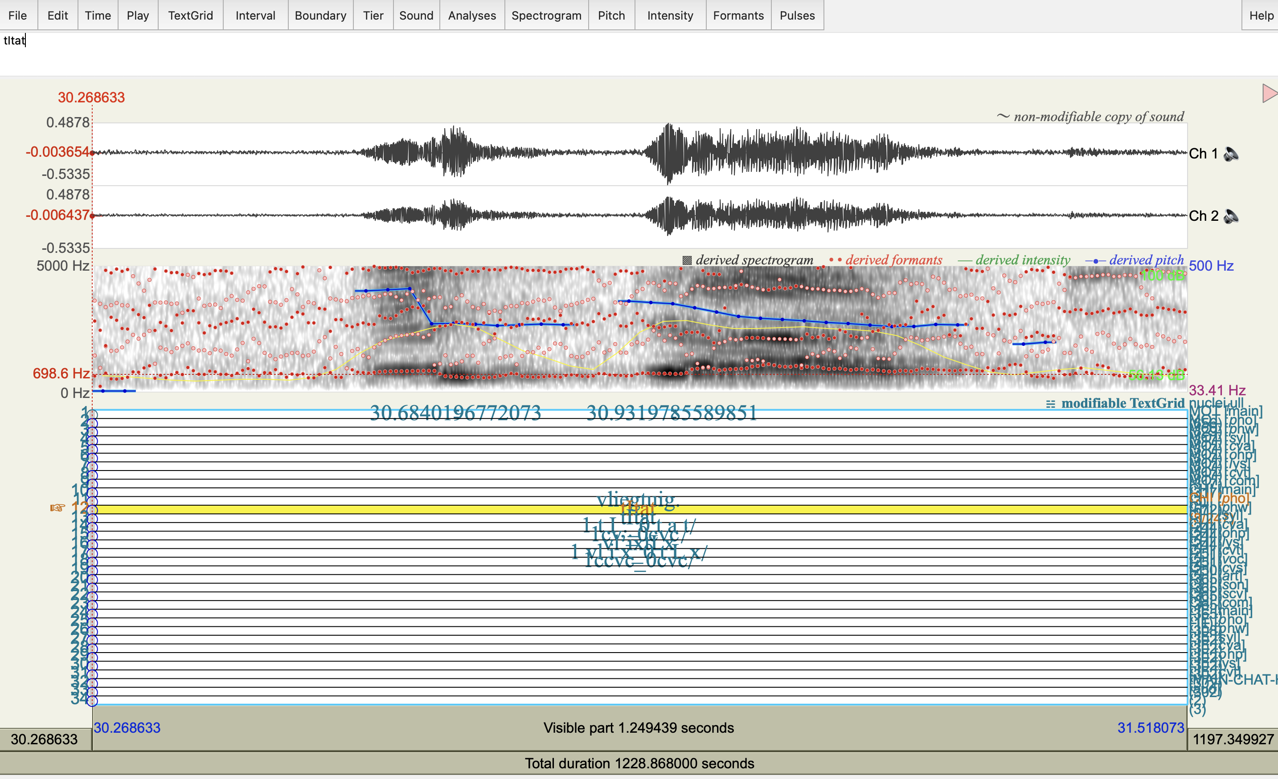
Definition of a Research Question
Data collection
Pre-processing
Acoustic analysis
Post-processing
Stats. Analysis
Interpretation
Clan Format
Praat Format
*MOT: niet aankomen.
%pho: n'i j'ankom@
%ohp: n'it 'ankom@n
*LIE: wie is dat?
%pho: w'I 'Is d'A
%ohp: w'i 'Is d'At
*CHI: boem.
%pho: n'um
%ohp: b'um

Slide 30
Definition of a Research Question
Data collection
Pre-processing
Acoustic analysis
Post-processing
Stats. Analysis
Interpretation
Clan Format
Praat Format
*CHI: boem.
%pho: n'um
%ohp: b’um
570 basic transcriptions (20 minutes) * 14h = 8000 h = 1000 work days

Slide 31
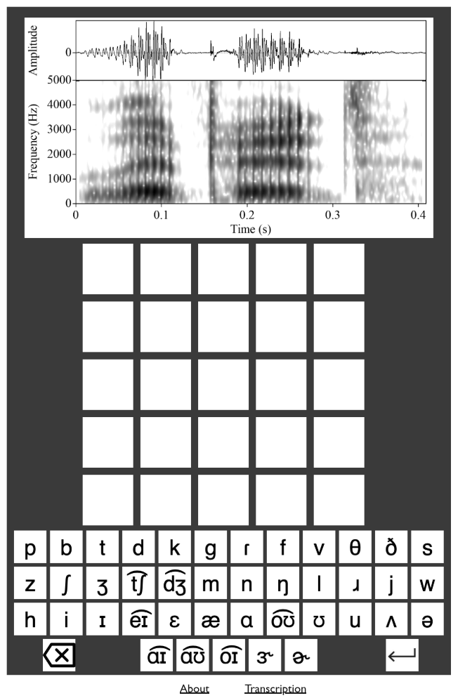
Definition of a Research Question
Data collection
Pre-processing
Acoustic analysis
Post-processing
Stats. Analysis
Interpretation
PRAAT: All information in one picture
GRAMLE
≃wordle
https://nascl.rc.nau.edu/about-gramle/
“READ A SPECTROGRAM”
Notes:
/laiped/
lipid

Slide 32
Definition of a Research Question
Data collection
Pre-processing
Acoustic analysis
Post-processing
Stats. Analysis
Interpretation
The original corpus does not often match what you need for your specific purpose
Two intermediate pre-processing steps:
- Selection of the needed data → vowels
- Annotation of the data → locate the vowels

Slide 33
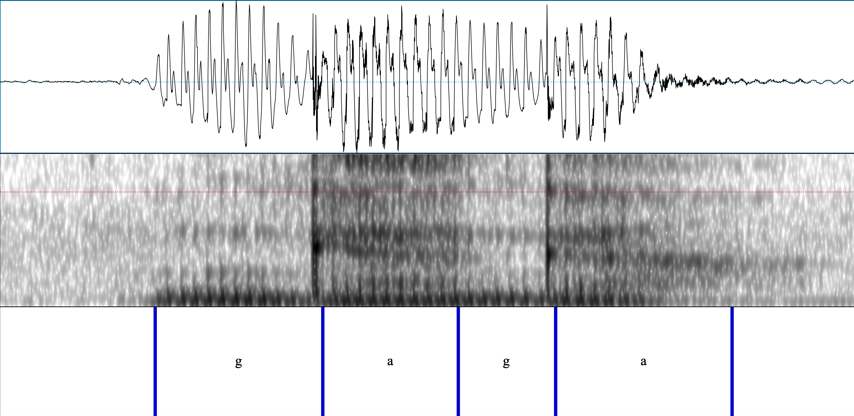
Definition of a Research Question
Data collection
Pre-processing
Acoustic analysis
Post-processing
Stats. Analysis
Interpretation

Slide 34

Definition of a Research Question
Data collection
Pre-processing
Acoustic analysis
Post-processing
Stats. Analysis
Interpretation
Centre of vowels
Automatic
- Fast
- Error prone
- No human bias
Manual
Slow
Less error prone
Human bias
A combination of both:
First automatic
Manual correction

Slide 35






Definition of a Research Question
Data collection
Pre-processing
Acoustic analysis
Post-processing
Stats. Analysis
Interpretation
Sound features:
- Time (When ?) -> Centre of vowels
Amplitude (How strong?) -> First frequency
Frequency (How high?) amplified

Slide 36
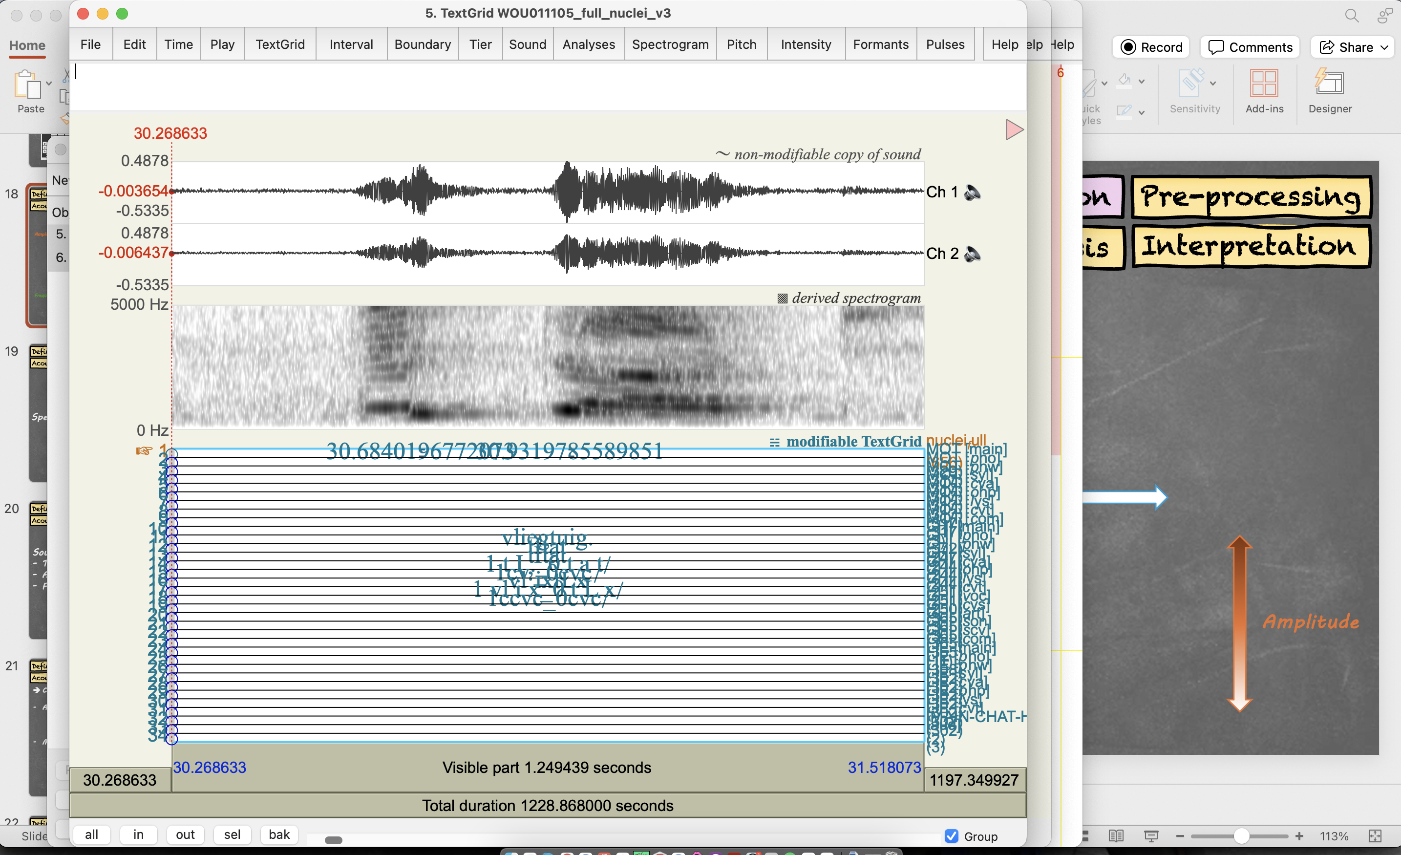
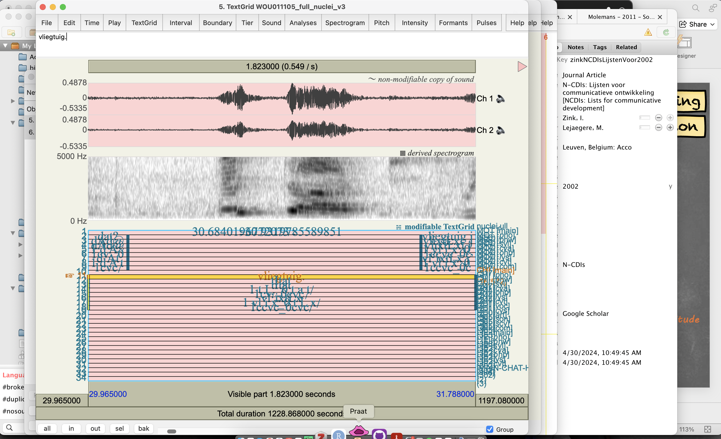
Definition of a Research Question
Data collection
Pre-processing
Acoustic analysis
Post-processing
Stats. Analysis
Interpretation
Amplitude
Time
Frequency
Amplitude
Notes:
WOU011105_full_nuclei_v3

Slide 37
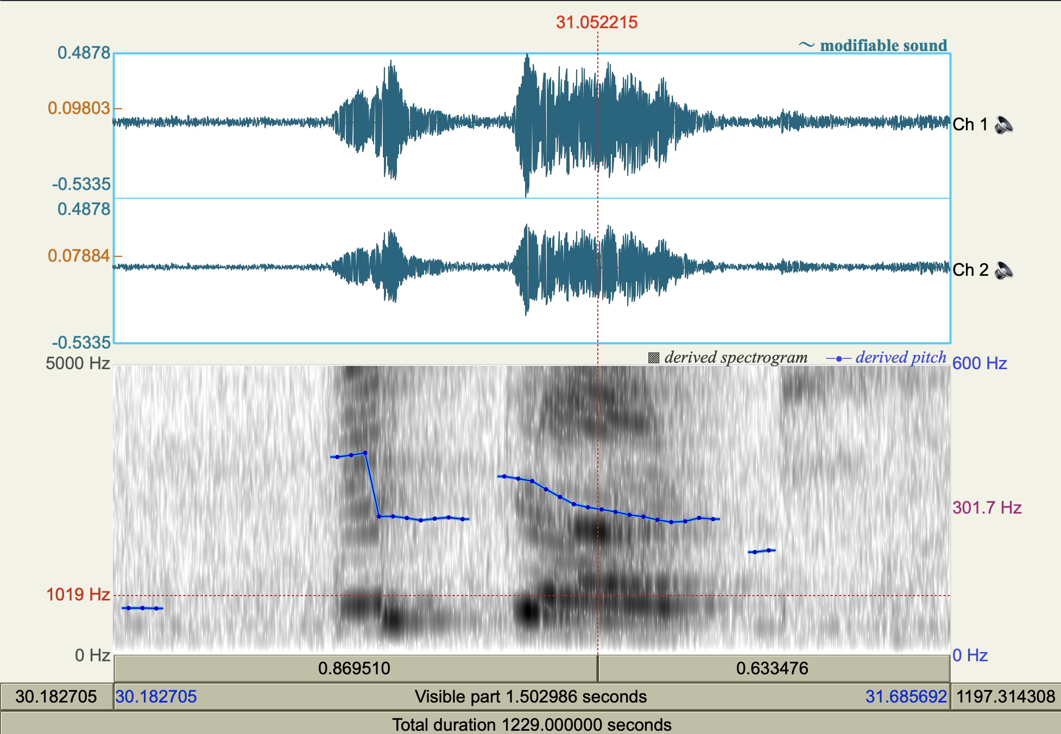
Definition of a Research Question
Data collection
Pre-processing
Acoustic analysis
Post-processing
Stats. Analysis
Interpretation
Pitch > Show pitch
Pitch > Advanced pitch settings…
Pitch > Get minimum pitch
Pitch > Get maximum pitch
Notes:
WOU011105_full_nuclei_v3

Slide 38
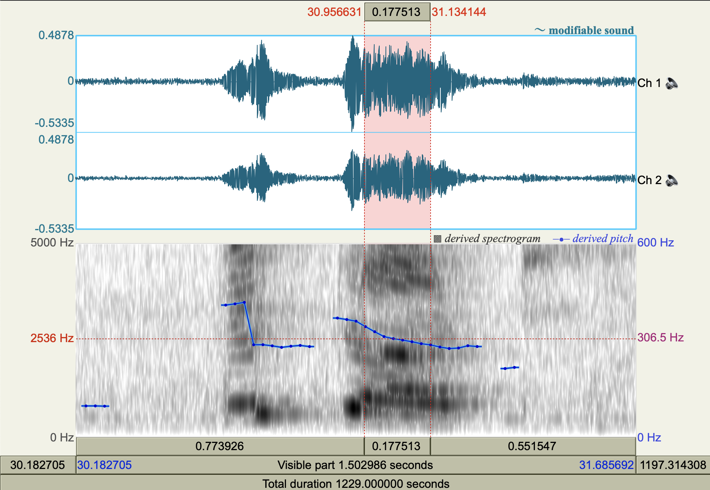
Definition of a Research Question
Data collection
Pre-processing
Acoustic analysis
Post-processing
Stats. Analysis
Interpretation
Pitch > Show pitch
Pitch > Advanced pitch settings…
Pitch > Get minimum pitch
Pitch > Get maximum pitch
Notes:
WOU011105_full_nuclei_v3

Slide 39
Definition of a Research Question
Data collection
Pre-processing
Acoustic analysis
Post-processing
Stats. Analysis
Interpretation
Good time resolution
Wide-band spectrogram
(≃ 5ms)
Spectrogram Settings
Narrow-band spectrogram
(≃ 100ms)
Good frequency resolution
Notes:
Good frequency resolution narrow wide band

Slide 40
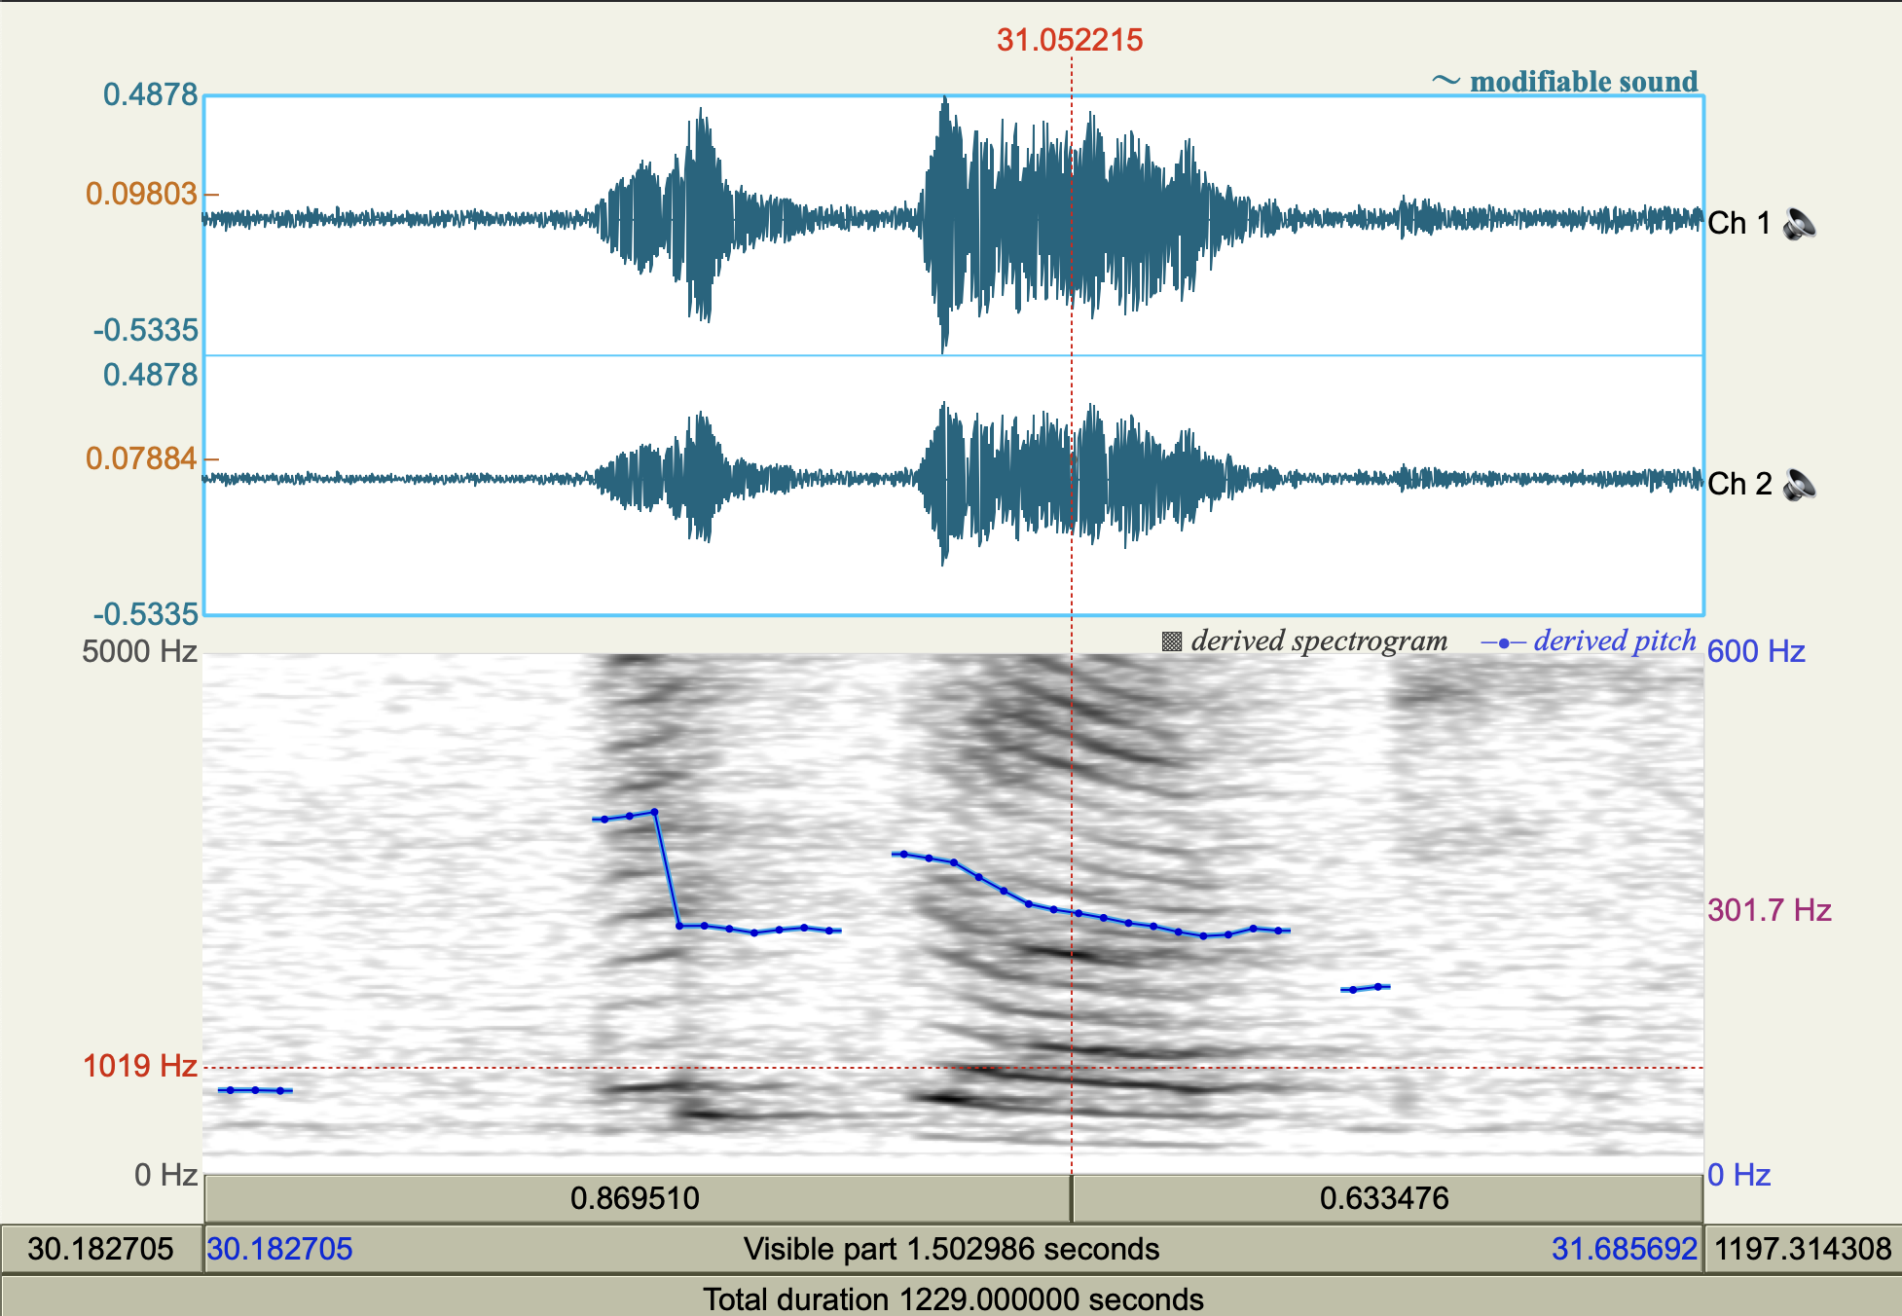
Definition of a Research Question
Data collection
Pre-processing
Acoustic analysis
Post-processing
Stats. Analysis
Interpretation
Pitch > Show pitch
Pitch > Advanced pitch settings…
Pitch > Get minimum pitch
Pitch > Get maximum pitch
Notes:
WOU011105_full_nuclei_v3

Slide 41
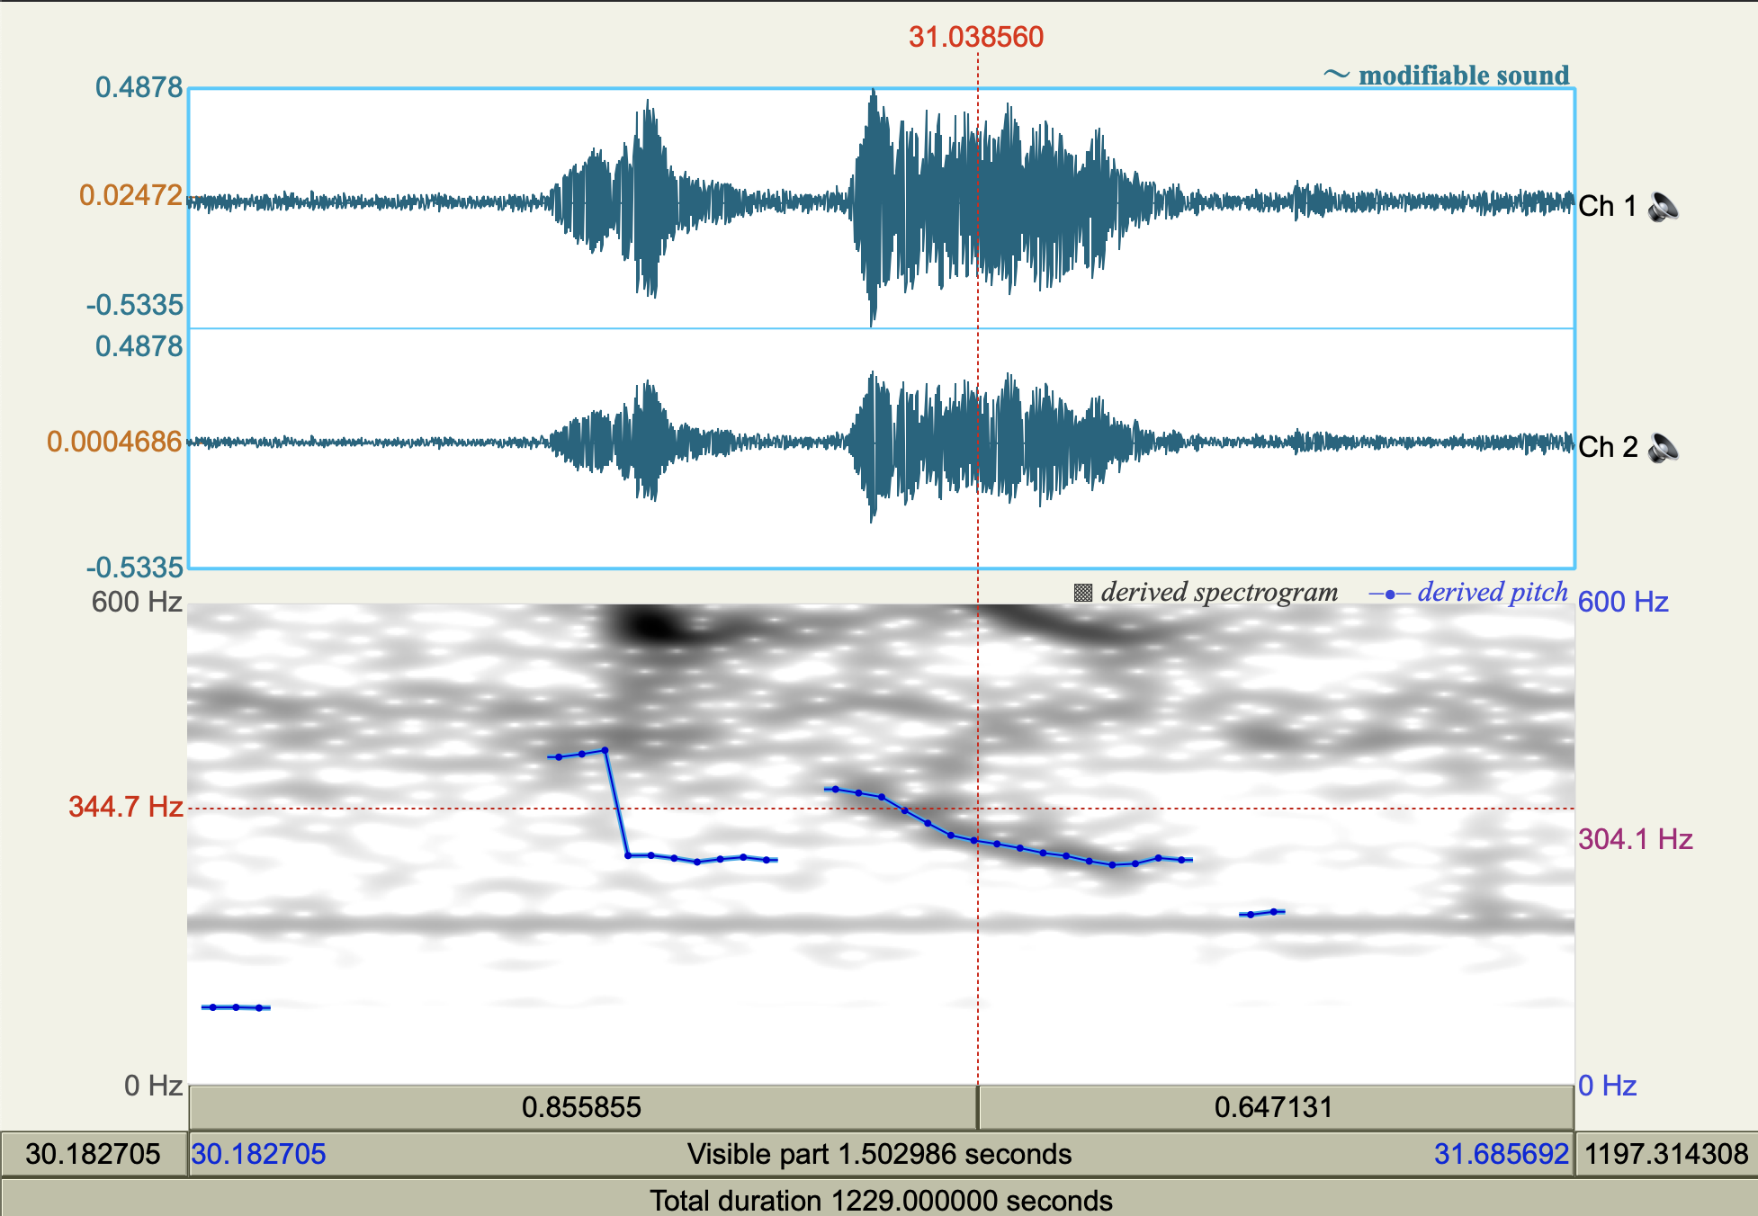
Definition of a Research Question
Data collection
Pre-processing
Acoustic analysis
Post-processing
Stats. Analysis
Interpretation
Pitch > Show pitch
Pitch > Advanced pitch settings…
Pitch > Get minimum pitch
Pitch > Get maximum pitch
Notes:
WOU011105_full_nuclei_v3

Slide 42
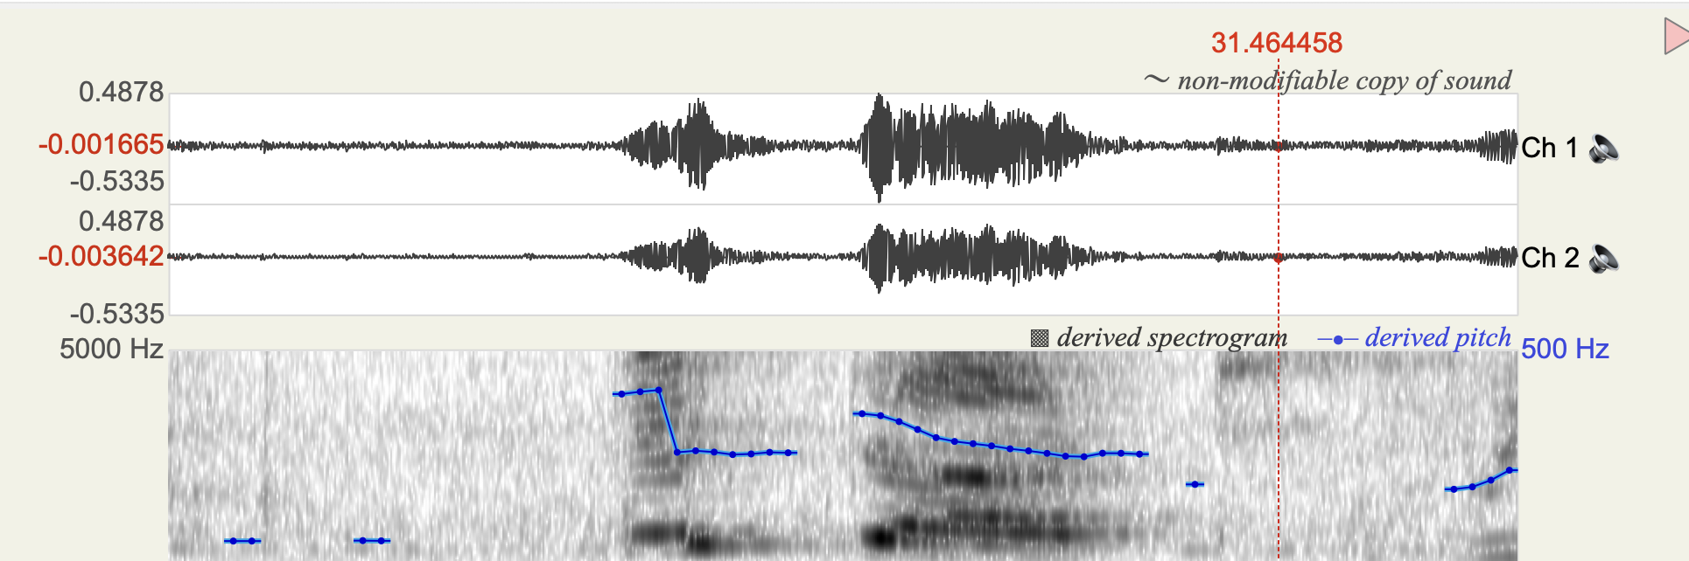
Definition of a Research Question
Data collection
Pre-processing
Acoustic analysis
Post-processing
Stats. Analysis
Interpretation
Tracking errors (octave jumps)
411
280
Notes:
Good frequency resolution narrow wide band

Slide 43
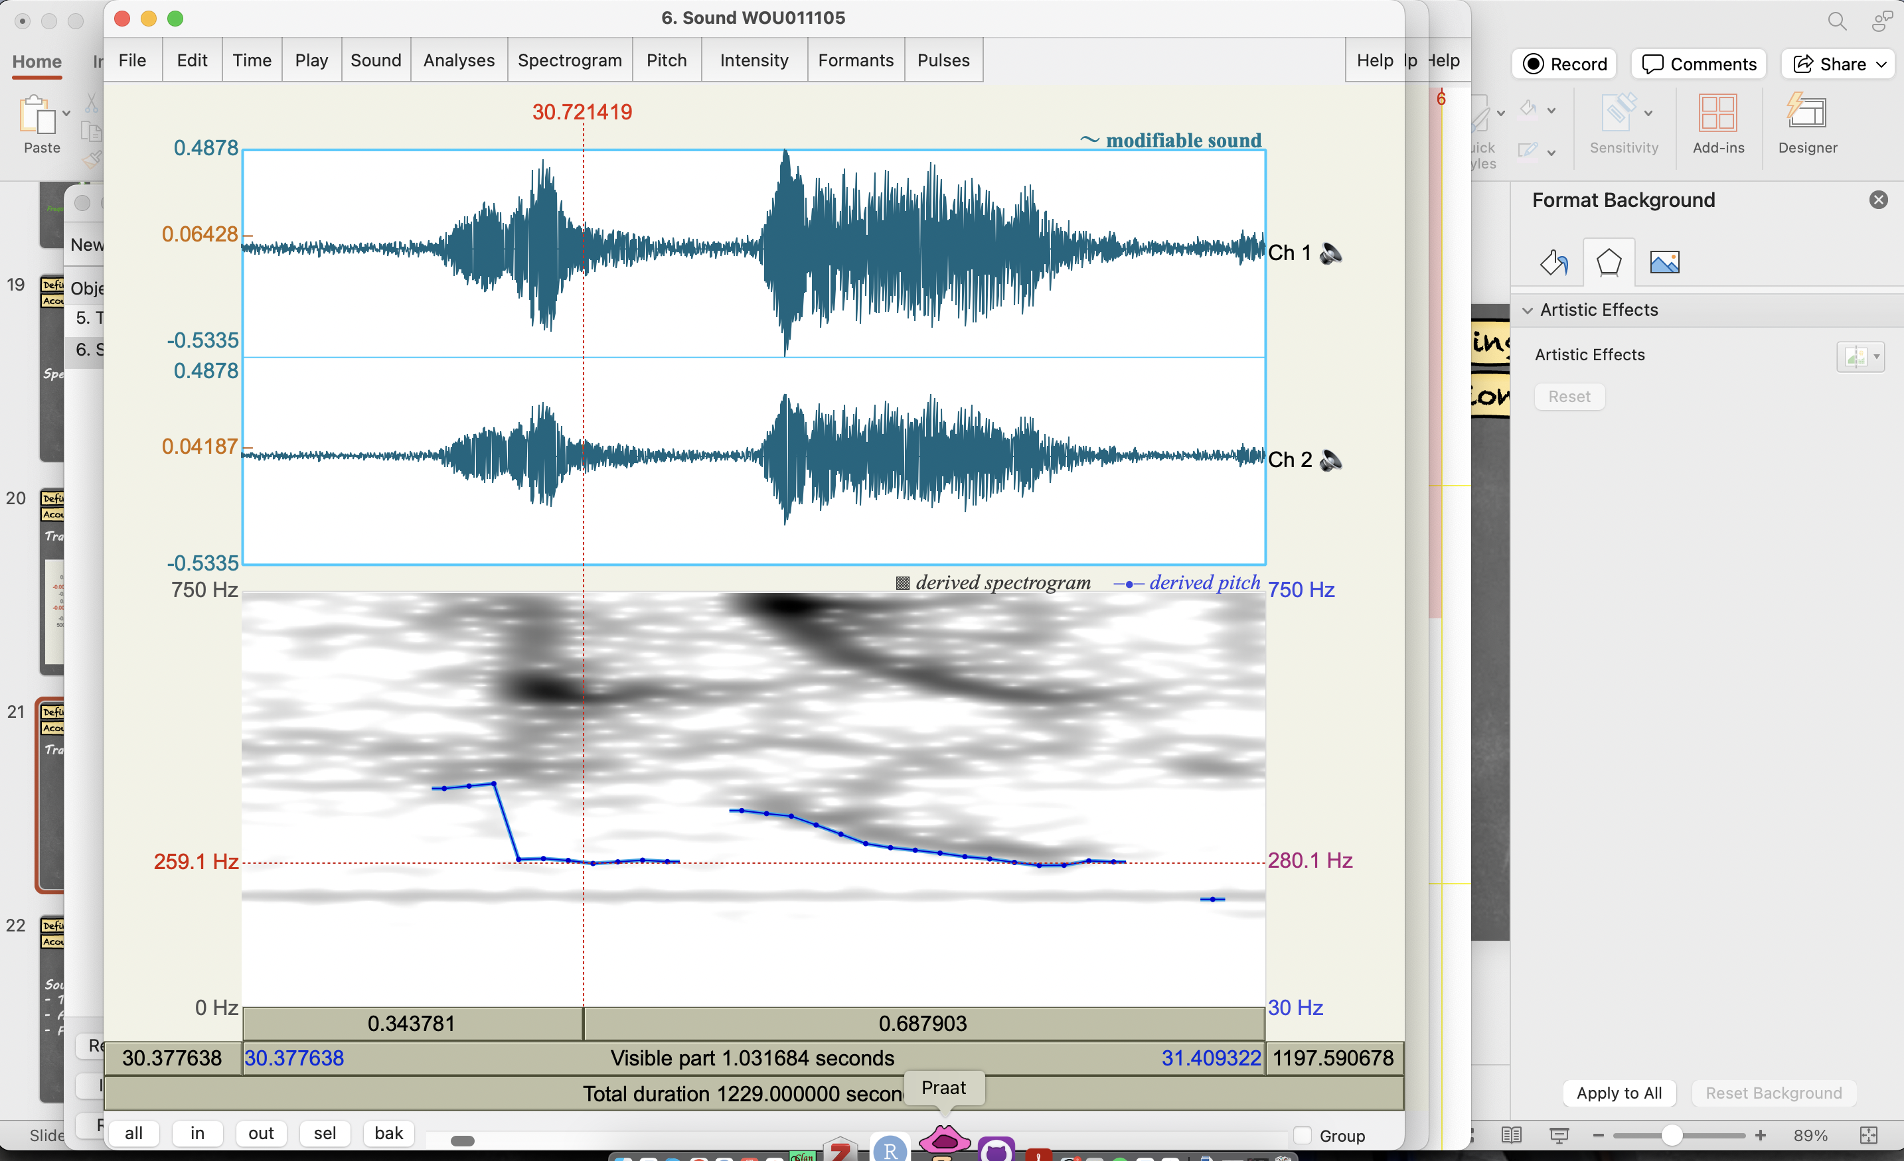


Definition of a Research Question
Data collection
Pre-processing
Acoustic analysis
Post-processing
Stats. Analysis
Interpretation
Tracking errors (octave jumps)
- usually real F0x2 or real F0/2
Solutions:
- “Kill octave jumps”
- Fine-tune your parameters
- Exclusion of outliers
- Manual correction
568
280
Notes:
Good frequency resolution narrow wide band

Slide 44
Definition of a Research Question
Data collection
Pre-processing
Acoustic analysis
Post-processing
Stats. Analysis
Interpretation
Selection of the relevant data
Vowels of the children
Vowels produced in lexical words
High and low vowels (no central vowels)
No vowels with background noise
Exclusion of outliers
Check if natural variation
Software/manual errors
Noise?
Manual exclusion
Automatic exclusion
DATA
Notes:
Good frequency resolution narrow wide band

Slide 45
Definition of a Research Question
Data collection
Pre-processing
Acoustic analysis
Post-processing
Stats. Analysis
Interpretation
Depending on statistical framework:
Category 1
Observe whether one dimension (one of the independent variables agreed upon at the beginning) can explain the observed variability
Category 2
Notes:
Good frequency resolution narrow wide band

Slide 46
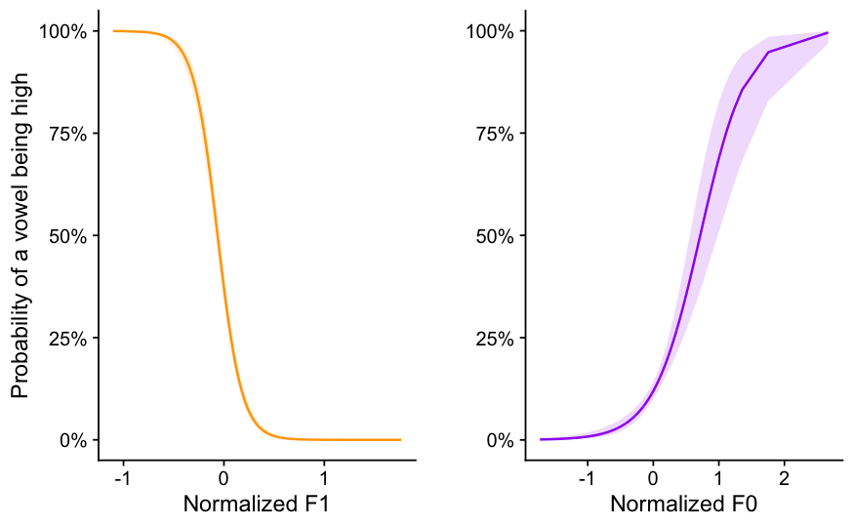
Definition of a Research Question
Data collection
Pre-processing
Acoustic analysis
Post-processing
Stats. Analysis
Interpretation
F1
F0
F0

Slide 47
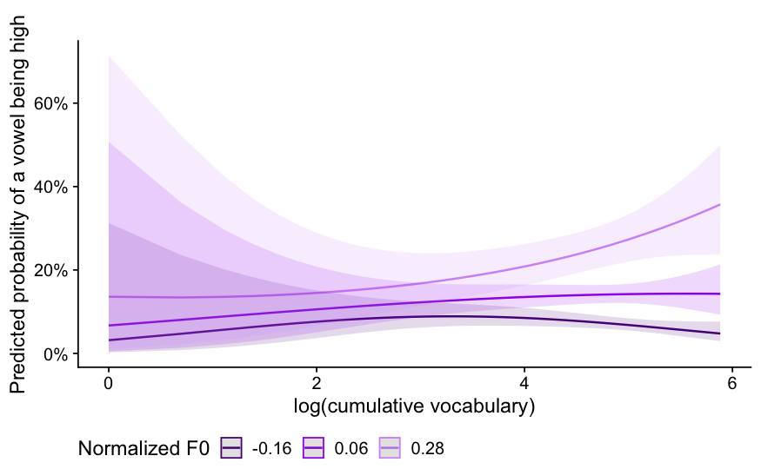

Definition of a Research Question
Data collection
Pre-processing
Acoustic analysis
Post-processing
Stats. Analysis
Interpretation
High vowels
Big phonetic difference
Small phonetic difference
Low vowels
Development

Slide 48
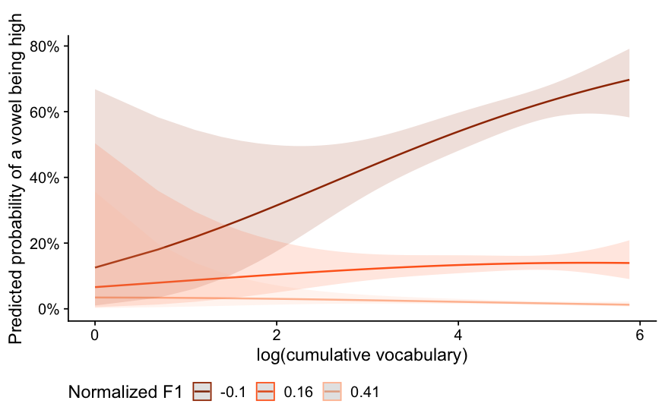
Definition of a Research Question
Data collection
Pre-processing
Acoustic analysis
Post-processing
Stats. Analysis
Interpretation
F1
F0
High vowels
Low vowels

Slide 49
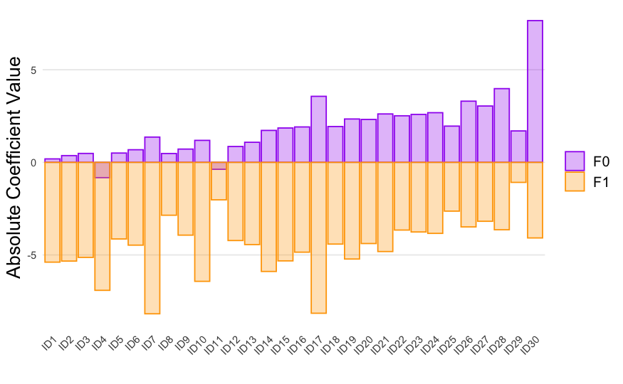
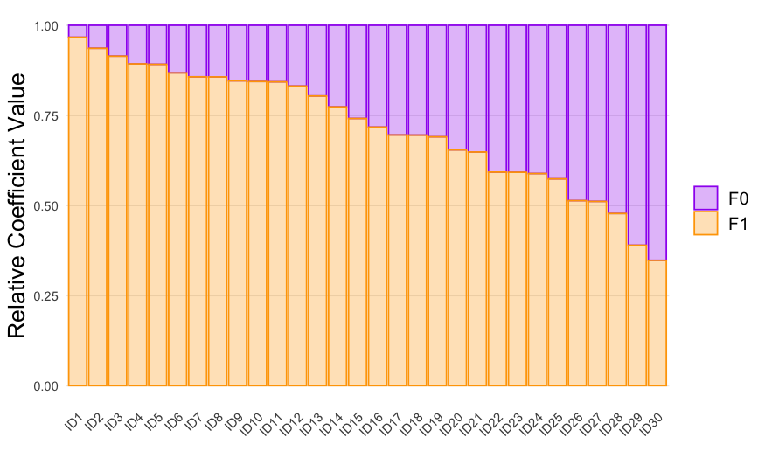
Definition of a Research Question
Data collection
Pre-processing
Acoustic analysis
Post-processing
Stats. Analysis
Interpretation
Children use more F1 than F0 for vowel height distinctions

Slide 50
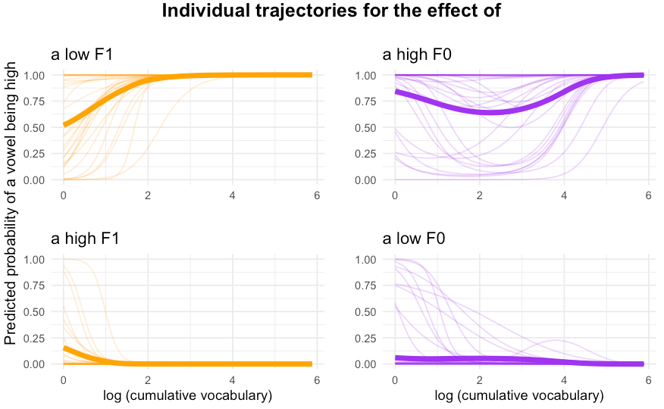
Definition of a Research Question
Data collection
Pre-processing
Acoustic analysis
Post-processing
Stats. Analysis
Interpretation
Later
& more difficult to learn
Size of the contrast between high & low vowels

Slide 51
Definition of a Research Question
Data collection
Pre-processing
Acoustic analysis
Post-processing
Stats. Analysis
Interpretation
Children use both F0 and F1 to convey the vowel height contrasts
The F0 contrast is acquired later than the F1 contrast
The acoustic contrast is marked on high vowels
There is large between-children variability in the use of both cues
→ Suggests PERCEPTUAL component of IF0

Slide 52
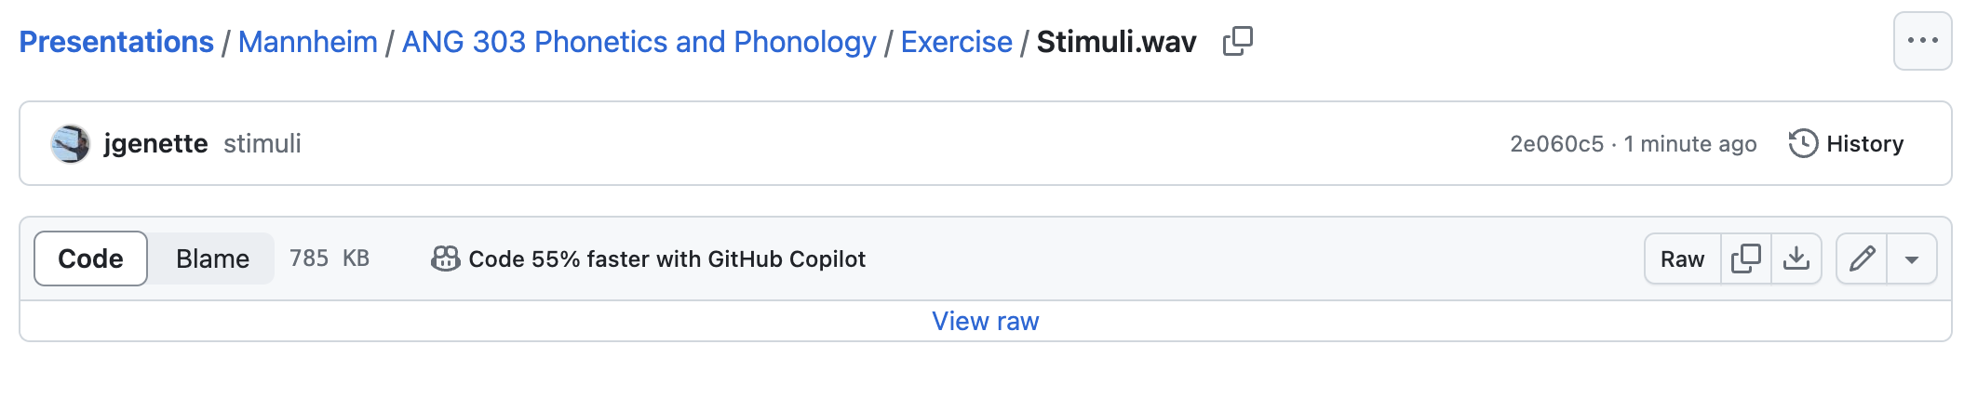

Exercise
https://github.com/jgenette
> Repositories
> Presentations > Mannheim > ANG 303 Phonetics and Phonology
> Exercise > Stimuli
Download

Slide 53


Questions?

Slide 54
Thank you for listening and good luck with your projects!!!

Slide 55


Exercise
https://github.com/jgenette
> Repositories
> Presentations > Mannheim > ANG 303 Phonetics and Phonology
> Exercise > Stimuli
<Paar>
<pur>
<Pier>
[paːɐ̯]
[puːɐ̯]
[piːɐ̯]

Slide 56
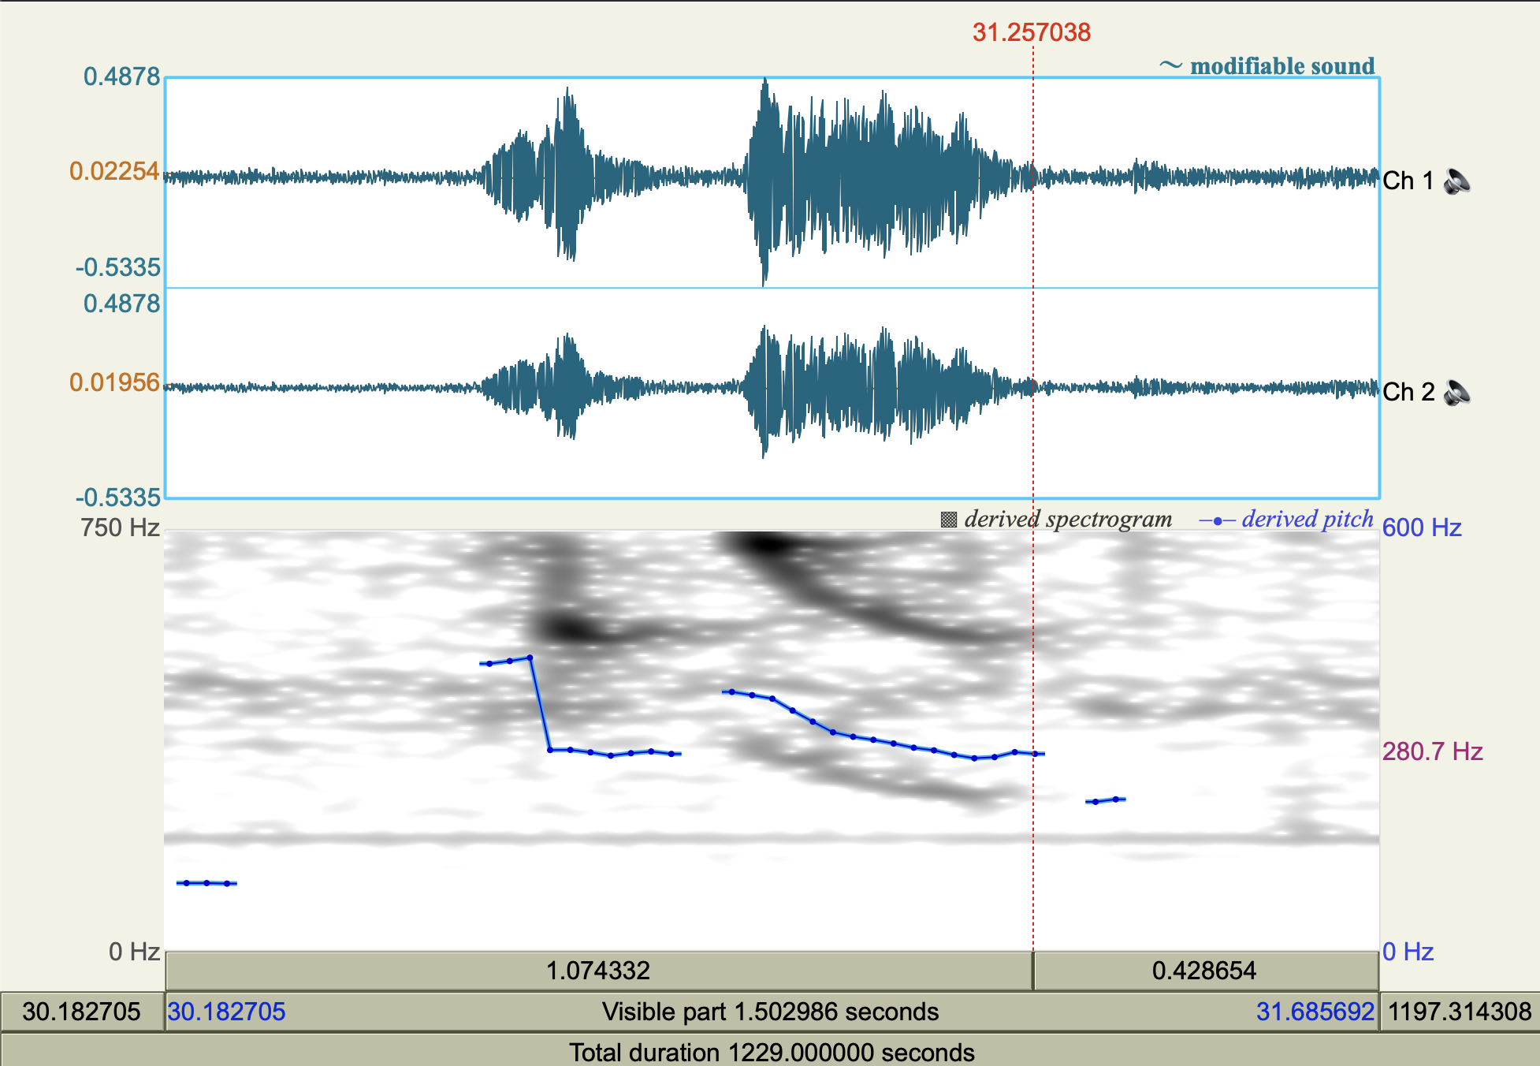
Definition of a Research Question
Data collection
Pre-processing
Acoustic analysis
Post-processing
Stats. Analysis
Interpretation
Pitch > Show pitch
Pitch > Advanced pitch settings…
Pitch > Get minimum pitch
Pitch > Get maximum pitch
Notes:
WOU011105_full_nuclei_v3

